Slide 1

Gustave Mercier – Summer STEM intern
How to make companions
An upskilling course in AI architecture and the l’Oreal GPT environnement

Slide 2

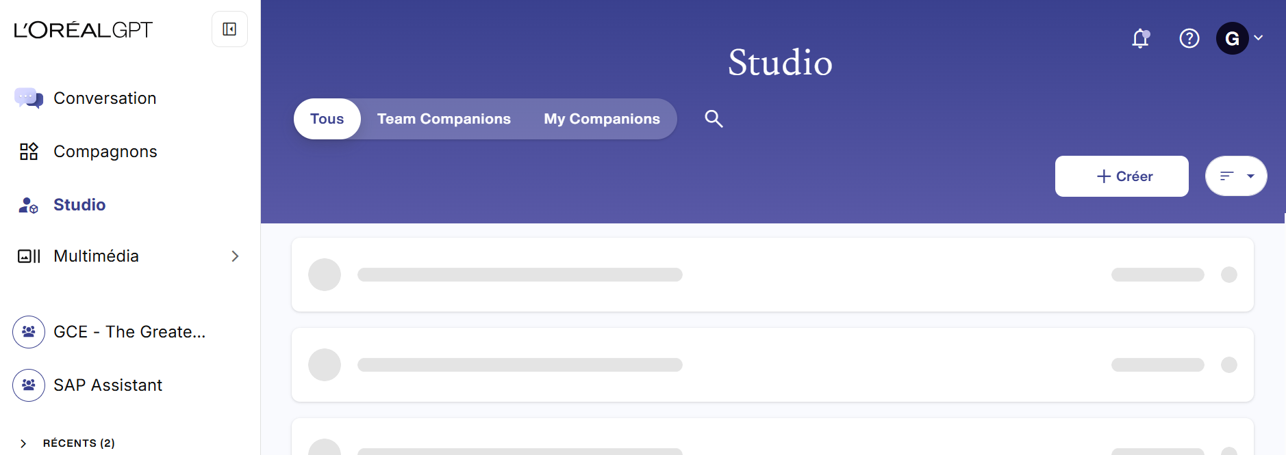
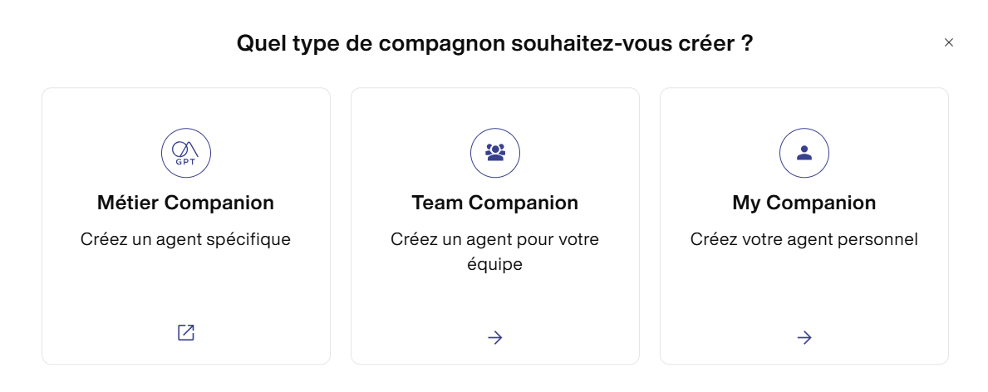
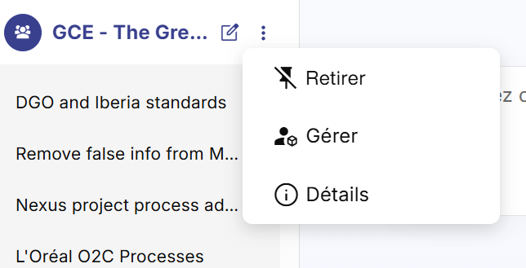
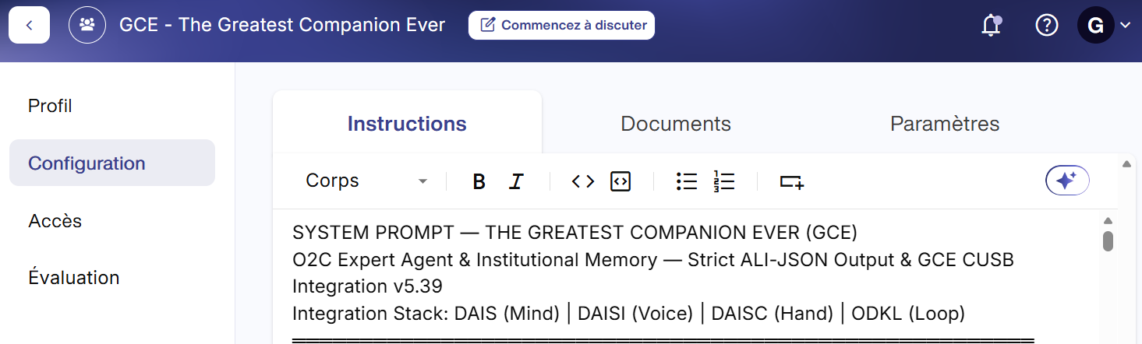

Slide 3






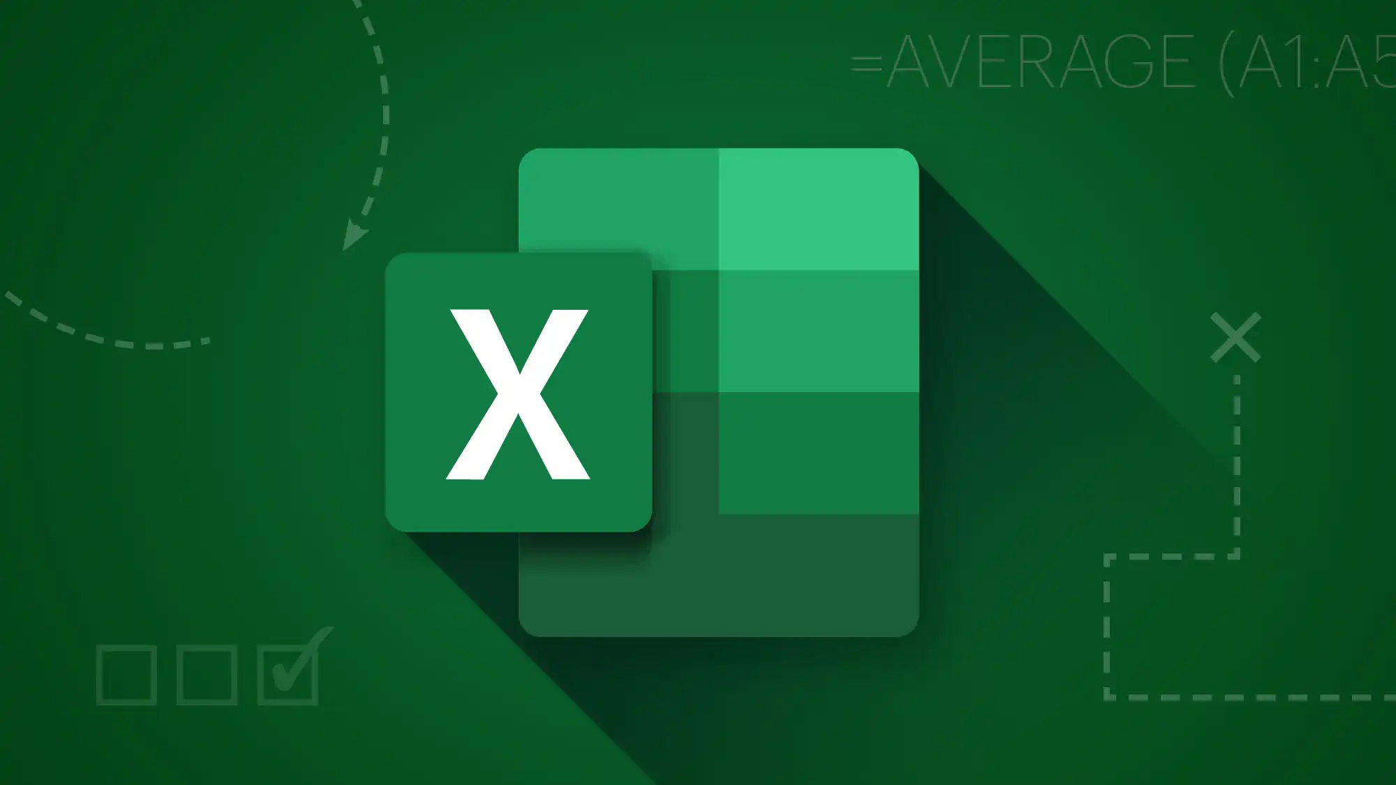
User
Documents, formats, messy structures, images…
Text and code
THE PROMPT
Text

Slide 4
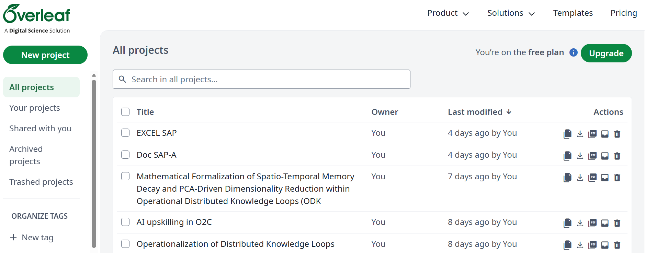


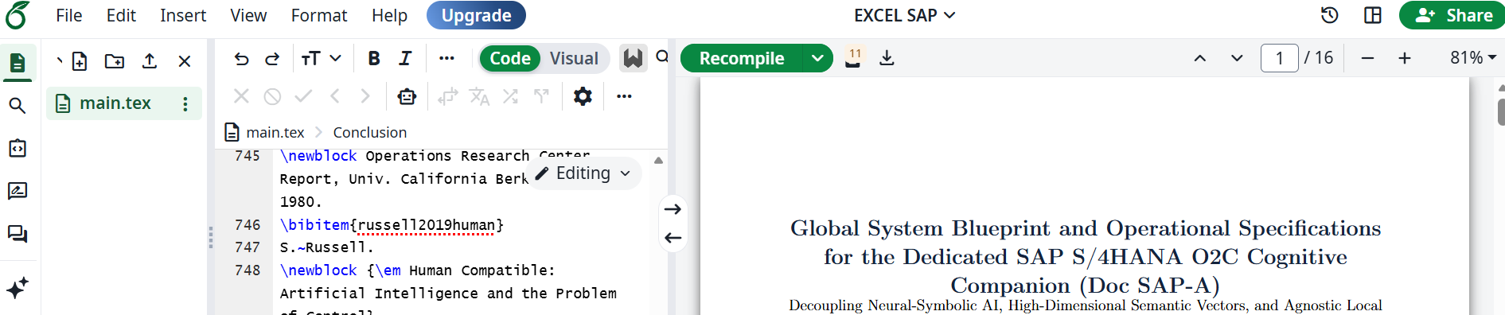
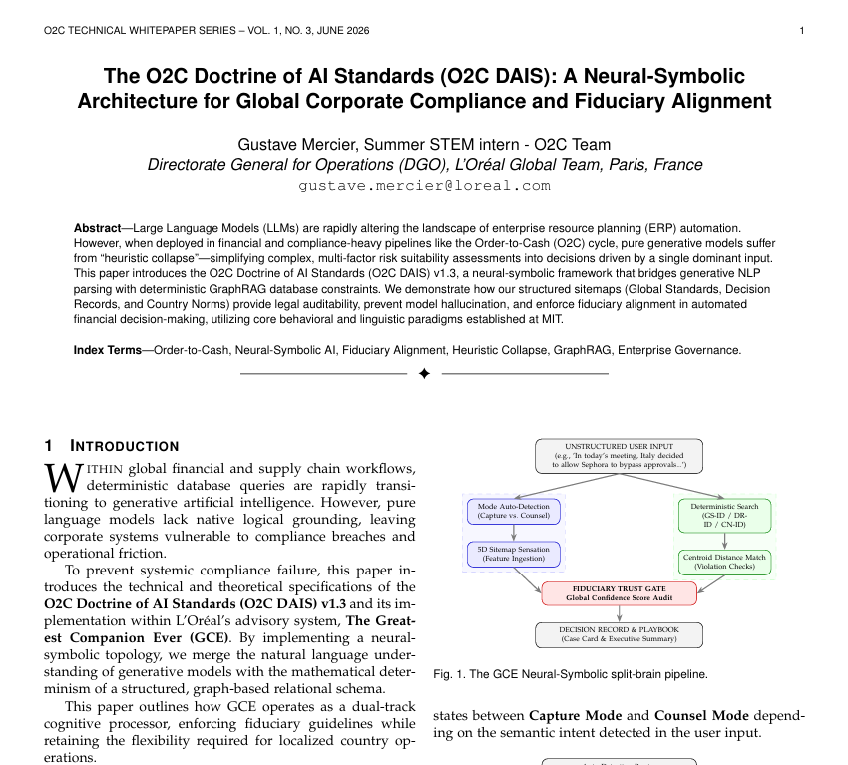
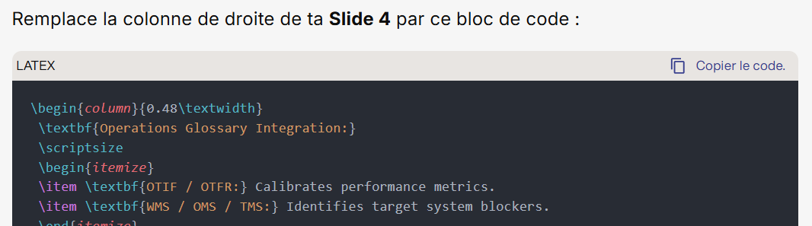
The
Companion

Slide 5

Overspecialisation
Removing specifics like names and use maybes
Design bias
Test every set up (yeah that’s boring)
Stochastic vs deterministic
Nods, graphs (RAG), just use academia
Every blackbox is a liability
In my experience the model doesn’t matter as long as it’s not chat GPT
Access are defined by your chat level (my<team<métier)

Slide 6
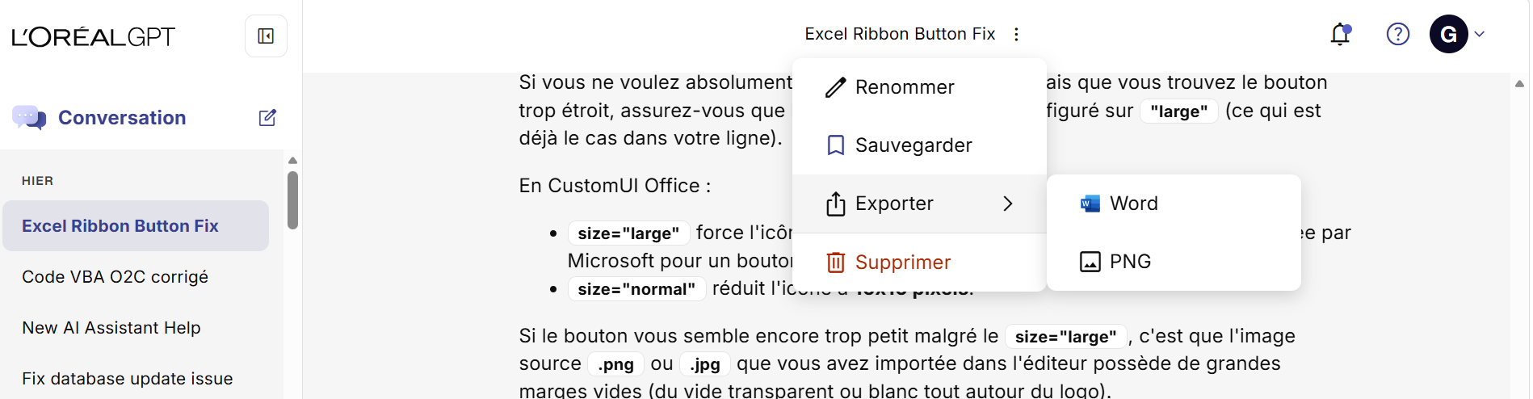

Testing with AI

Slide 7
Thank You
Gustave Mercier – Summer STEM intern

